Slide 1
Murach’s PHP and MySQL (4th Edition)
Chapter 4
How to use PHP with a MySQL database

Slide 2
Applied objectives
Given the specifications for a database application that requires only the skills that are presented in this chapter, develop the application. That includes:
  Connecting to a MySQL database
  Executing SELECT, INSERT, UPDATE, and DELETE statements
  Handling PDO exceptions
  Getting the data from the result sets that are returned by SQL statements

Slide 3
Knowledge objectives
Describe the PHP code for creating a PDO object that connects to a MySQL database.
Describe the use of the PDO methods for executing a SELECT, INSERT, UPDATE, or DELETE statement.
Describe the PHP code for handling the PDO exceptions that may occur when you try to create a PDO object.
Describe a PHP array and the way that numeric and string indexes are used to access its data.
Describe the way the fetch method of a PDOStatement object is used to get data from the first row of a result set and the way a foreach statement is used to get the data from all the rows of a result set.

Slide 4
The syntax for creating an object from any class
new ClassName(arguments);
The syntax for creating a database object
from the PDO class
new PDO($dsn, $username, $password);
The syntax for a DSN (Data Source Name)
for a MySQL database
mysql:host=host_address;dbname=database_name

Slide 5
How to connect to a MySQL database
$dsn = 'mysql:host=localhost;dbname=my_guitar_shop1';
$username = 'mgs_user';
$password = 'pa55word';
// creates PDO object
$db = new PDO($dsn, $username, $password);

Slide 6
Key terms for using PDO objects
class
object
argument
PDO object
DSN (Data Source Name)
PDO (PHP Data objects) extension
method

Slide 7
The syntax for a try/catch statement
try {
// statements that might throw an exception
} catch (ExceptionClass $exception_name) {
// statements that handle the exception
}
The syntax for executing a method of any object
$objectName->methodName(argumentList)

Slide 8
How to handle a PDO exception
try {
$db = new PDO($dsn, $username, $password);
echo '<p>You are connected to the database!</p>';
} catch (PDOException $e) {
$error_message = $e->getMessage();
echo '<p>An error occurred while connecting to
the database: $error_message </p>’;
}
How to handle any type of exception
try {
// statements that might throw an exception
} catch (Exception $e) {
$error_message = $e->getMessage();
echo '<p>Error message: $error_message </p>';
}

Slide 9
Key terms for handling exceptions
exception
exception handling
throw an exception
try/catch statement
try block
catch block
Exception class
PDOException class

Slide 10
A method of the PDO class for preparing a SQL statement
Method | Description
prepare($sql_statement) | Prepares the specified SQL statement for execution and returns a PDOStatement object. Within the SQL statement, you can use a colon (:) to identify named parameters.

Slide 11
Two methods of the PDOStatement class for executing a statement
Method | Description
bindValue($param, $value) | Binds the specified value to the specified parameter in the prepared statement.
execute() | Executes the prepared statement.

Slide 12
Execute a SQL statement with no parameters
$query = 'SELECT * FROM products';
$statement = $db->prepare($query);
$statement->execute();
Execute a SQL statement with a parameter
$query = 'SELECT * FROM products
WHERE categoryID = :category_id';
$statement = $db->prepare($query);
$statement->bindValue(':category_id', $category_id);
$statement->execute();

Slide 13
Two more methods of the PDOStatement class
Method | Description
fetch() | Returns an array for the next row in the result set. If no array is available, this method returns a FALSE value.
closeCursor() | Frees the connection to the server so other SQL statements may be issued.

Slide 14
Code that returns a result set with one row
$query = 'SELECT productCode, productName, listPrice
FROM products
WHERE productID = :product_id';
$statement = $db->prepare($query);
$statement->bindValue(':product_id', $product_id);
$statement->execute();
$product = $statement->fetch();
$statement->closeCursor();

Slide 15
Using a string index to access each column
$product_code = $product['productCode'];
$product_name = $product['productName'];
$product_list_price = $product['listPrice'];
Using a numeric index to access each column
$product_code = $product[0];
$product_name = $product[1];
$product_list_price = $product[2];

Slide 16
Key terms for arrays
array
element
index

Slide 17
Another method of the PDOStatement class
Method | Description
fetchAll() | Returns an array for all of the rows in the result set.
Code that returns a result set of two or more rows
$query = 'SELECT productCode, productName, listPrice
FROM products
WHERE categoryID = :category_id;'
$statement = $db->prepare($query);
$statement->bindValue(':category_id', $category_id);
$statement->execute();
$products = $statement->fetchAll();
$statement->closeCursor();

Slide 18
How to use a foreach statement to display the result set in an HTML table
<?php foreach ($products as $product) { ?>
<tr>
<td><?php echo $product['productCode']; ?></td>
<td><?php echo $product['productName']; ?></td>
<td><?php echo $product['listPrice']; ?></td>
</tr>
<?php } ?>
Another syntax for the foreach statement
that works better within PHP tags
<?php foreach ($products as $product) : ?>
<tr>
<td><?php echo $product['productCode']; ?></td>
<td><?php echo $product['productName']; ?></td>
<td><?php echo $product['listPrice']; ?></td>
</tr>
<?php endforeach; ?>

Slide 19
How to execute an INSERT statement
$category_id = 1;
$code = 'strat';
$name = 'Fender Stratocaster';
$price = 699.99;
$query = 'INSERT INTO products
(categoryID, productCode, productName, listPrice)
VALUES
(:category_id, :code, :name, :price)';
$statement = $db->prepare($query);
$statement->bindValue(':category_id', $category_id);
$statement->bindValue(':code', $code);
$statement->bindValue(':name', $name);
$statement->bindValue(':price', $price);
$statement->execute();
$statement->closeCursor();

Slide 20
How to execute an UPDATE statement
$product_id = 4;
$price = 599.99;
$query = 'UPDATE products
SET listPrice = :price
WHERE productID = :product_id';
$statement = $db->prepare($query);
$statement->bindValue(':price', $price);
$statement->bindValue(':product_id', $product_id);
$statement->execute();
$statement->closeCursor();

Slide 21
How to execute a DELETE statement
$product_id = 4;
$query = 'DELETE FROM products
WHERE productID = :product_id';
$statement = $db->prepare($query);
$statement->bindValue(':product_id', $product_id);
$statement->execute();
$statement->closeCursor();

Slide 22
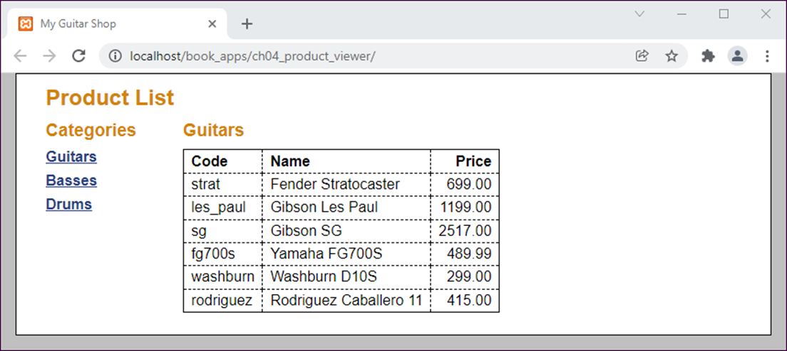
The user interface

Slide 23
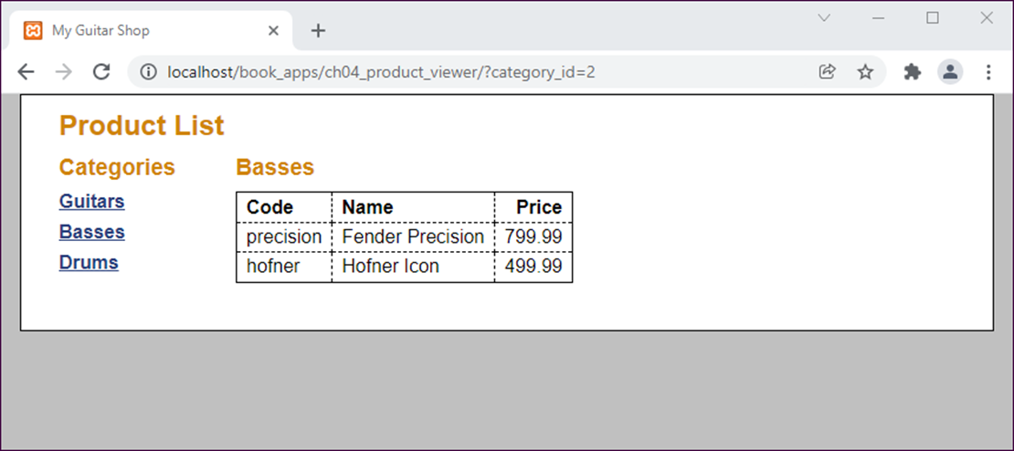
The user interface after the user selects a different category

Slide 24
The database.php file
<?php
$dsn = 'mysql:host=localhost;dbname=my_guitar_shop1';
$username = 'mgs_user';
$password = 'pa55word';
try {
$db = new PDO($dsn, $username, $password);
} catch (PDOException $e) {
$error_message = $e->getMessage();
include('database_error.php');
exit();
}
?>

Slide 25
The database_error.php file
<!DOCTYPE html>
<html>
<!-- the head section -->
<head>
<title>My Guitar Shop</title>
<link rel="stylesheet" href="main.css">
</head>
<!-- the body section -->
<body>
<main>
<h1>Database Error</h1>
<p>There was an error connecting to the database.</p>
<p>The database must be installed as described in the
appendix.</p>
<p>The database must be running as described in chapter 1.
</p>
<p>Error message: <?php echo $error_message; ?></p>
</main>
</body>
</html>

Slide 26
Product Viewer: index.php file (part 1)
<?php
require('database.php');
// Get category ID
$category_id = filter_input(INPUT_GET, 'category_id',
FILTER_VALIDATE_INT);
if ($category_id == NULL || $category_id == FALSE) {
$category_id = 1;
}
// Get name for selected category
$queryCategory = 'SELECT * FROM categories
WHERE categoryID = :category_id';
$statement1 = $db->prepare($queryCategory);
$statement1->bindValue(':category_id', $category_id);
$statement1->execute();
$category = $statement1->fetch();
$category_name = $category['categoryName'];
$statement1->closeCursor();

Slide 27
Product Viewer: index.php file (part 2)
// Get all categories
$queryAllCategories = 'SELECT * FROM categories
ORDER BY categoryID';
$statement2 = $db->prepare($queryAllCategories);
$statement2->execute();
$categories = $statement2->fetchAll();
$statement2->closeCursor();
// Get products for selected category
$queryProducts = 'SELECT * FROM products
WHERE categoryID = :category_id
ORDER BY productID';
$statement3 = $db->prepare($queryProducts);
$statement3->bindValue(':category_id', $category_id);
$statement3->execute();
$products = $statement3->fetchAll();
$statement3->closeCursor();
?>

Slide 28
Product Viewer: index.php file (part 3)
<!DOCTYPE html>
<html>
<head>
<title>My Guitar Shop</title>
<link rel="stylesheet" href="main.css" />
</head>
<body>
<main>
<h1>Product List</h1>
<aside>
<h2>Categories</h2>
<nav>
<ul>
<?php foreach ($categories as $category) : ?>
<li>
<a href="?category_id=<?php
echo $category['categoryID']; ?>">
<?php echo $category['categoryName']; ?></a>
</li>
<?php endforeach; ?>
</ul>
</nav>
</aside>

Slide 29
Product Viewer: index.php file (part 4)
<section>
<h2><?php echo $category_name; ?></h2>
<table>
<tr>
<th>Code</th>
<th>Name</th>
<th class="right">Price</th>
</tr>
<?php foreach ($products as $product) : ?>
<tr>
<td><?php echo $product['productCode']; ?></td>
<td><?php echo $product['productName']; ?></td>
<td class="right"><?php echo $product['listPrice']; ?>
</td>
</tr>
<?php endforeach; ?>
</table>
</section>
</main>
<footer></footer>
</body>
</html>

Slide 30
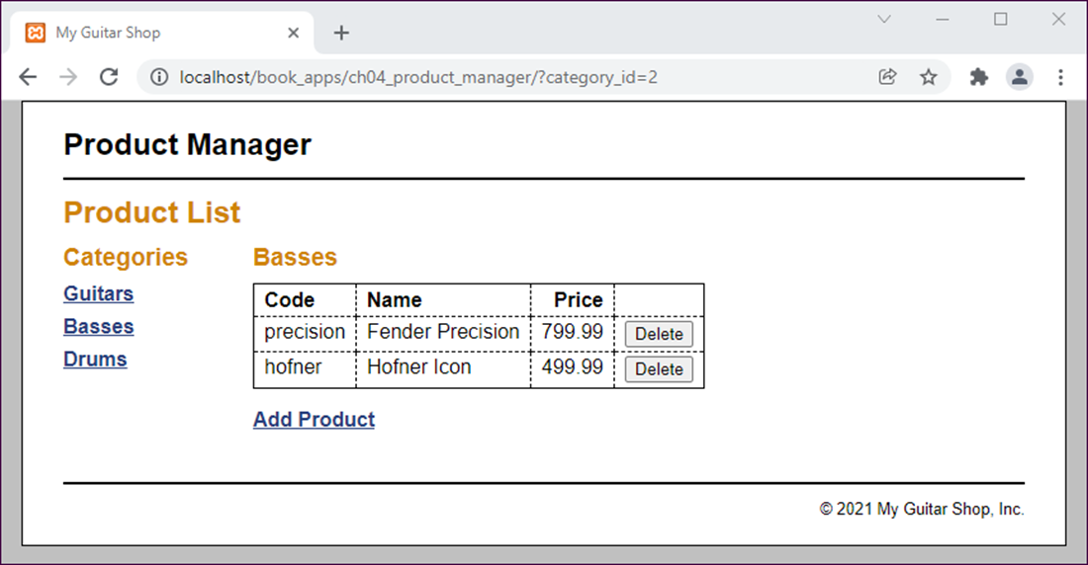
The Product List page

Slide 31
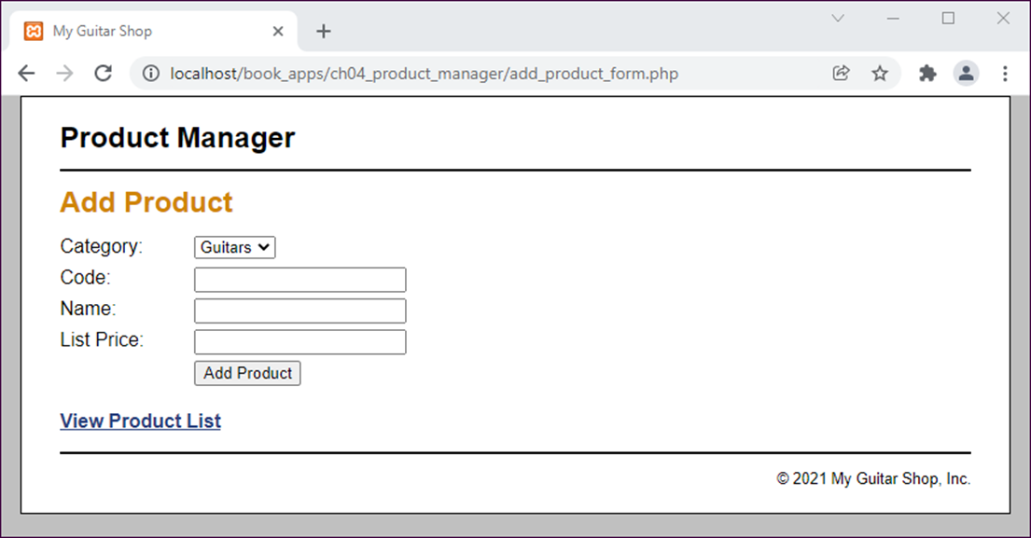
The Add Product page

Slide 32
Product Manager: index.php file (part 1)
<?php
require_once('database.php');
// Get category ID
if (!isset($category_id)) {
$category_id = filter_input(INPUT_GET, 'category_id',
FILTER_VALIDATE_INT);
if ($category_id == NULL || $category_id == FALSE) {
$category_id = 1;
}
}
// Get name for selected category
$queryCategory = 'SELECT * FROM categories
WHERE categoryID = :category_id';
$statement1 = $db->prepare($queryCategory);
$statement1->bindValue(':category_id', $category_id);
$statement1->execute();
$category = $statement1->fetch();
$category_name = $category['categoryName'];
$statement1->closeCursor();

Slide 33
Product Manager: index.php file (part 2)
// Get all categories
$queryAllCategories = 'SELECT * FROM categories
ORDER BY categoryID';
$statement2 = $db->prepare($queryAllCategories);
$statement2->execute();
$categories = $statement2->fetchAll();
$statement2->closeCursor();
// Get products for selected category
$queryProducts = 'SELECT * FROM products
WHERE categoryID = :category_id
ORDER BY productID';
$statement3 = $db->prepare($queryProducts);
$statement3->bindValue(':category_id', $category_id);
$statement3->execute();
$products = $statement3->fetchAll();
$statement3->closeCursor();
?>

Slide 34
Product Manager: index.php file (part 3)
<!DOCTYPE html>
<html>
<head>
<title>My Guitar Shop</title>
<link rel="stylesheet" href="main.css" />
</head>
<body>
<header><h1>Product Manager</h1></header>
<main>
<h1>Product List</h1>
<aside>
<!-- display a list of categories -->
<h2>Categories</h2>
<nav>
<ul>
<?php foreach ($categories as $category) : ?>
<li><a href=".?category_id=<?php
echo $category['categoryID']; ?>">
<?php echo $category['categoryName']; ?>
</a>
</li>

Slide 35
Product Manager: index.php file (part 4)
<?php endforeach; ?>
</ul>
</nav>
</aside>
<section>
<!-- display a table of products -->
<h2><?php echo $category_name; ?></h2>
<table>
<tr>
<th>Code</th>
<th>Name</th>
<th class="right">Price</th>
<th>&nbsp;</th>
</tr>
<?php foreach ($products as $product) : ?>
<tr>
<td><?php echo $product['productCode']; ?></td>
<td><?php echo $product['productName']; ?></td>
<td class="right"><?php echo $product['listPrice']; ?>
</td>

Slide 36
Product Manager: index.php file (part 5)
<td><form action="delete_product.php" method="post">
<input type="hidden" name="product_id"
value="<?php echo $product['productID']; ?>">
<input type="hidden" name="category_id"
value="<?php echo $product['categoryID']; ?>">
<input type="submit" value="Delete">
</form></td>
</tr>
<?php endforeach; ?>
</table>
<p><a href="add_product_form.php">Add Product</a></p>
</section>
</main>
<footer>
<p>&copy; <?php echo date('Y'); ?> My Guitar Shop, Inc.</p>
</footer>
</body>
</html>

Slide 37
The delete_product.php file
<?php
require_once('database.php');
$product_id = filter_input(INPUT_POST, 'product_id',
FILTER_VALIDATE_INT);
$category_id = filter_input(INPUT_POST, 'category_id',
FILTER_VALIDATE_INT);
// Delete the product from the database
if ($product_id != false && $category_id != false) {
$query = 'DELETE FROM products
WHERE productID = :product_id';
$statement = $db->prepare($query);
$statement->bindValue(':product_id', $product_id);
$success = $statement->execute();
$statement->closeCursor();
}
// Display the Product List page
include('index.php');

Slide 38
The add_product_form.php file (part 1)
<?php
require_once('database.php');
$query = 'SELECT *
FROM categories
ORDER BY categoryID';
$statement = $db->prepare($query);
$statement->execute();
$categories = $statement->fetchAll();
$statement->closeCursor();
?>
<!DOCTYPE html>
<html>
<head>
<title>My Guitar Shop</title>
<link rel="stylesheet" href="main.css">
</head>

Slide 39
The add_product_form.php file (part 2)
<body>
<header><h1>Product Manager</h1></header>
<main>
<h1>Add Product</h1>
<form action="add_product.php" method="post"
id="add_product_form">
<label>Category:</label>
<select name="category_id">
<?php foreach ($categories as $category) : ?>
<option value="<?php
echo $category['categoryID']; ?>">
<?php echo $category['categoryName']; ?>
</option>
<?php endforeach; ?>
</select><br>

Slide 40
The add_product_form.php file (part 3)
<label>Code:</label>
<input type="text" name="code"><br>
<label>Name:</label>
<input type="text" name="name"><br>
<label>List Price:</label>
<input type="text" name="price"><br>
<label>&nbsp;</label>
<input type="submit" value="Add Product"><br>
</form>
<p><a href="index.php">View Product List</a></p>
</main>
<footer>
<p>&copy; <?php echo date('Y'); ?>
My Guitar Shop, Inc.</p>
</footer>
</body>
</html>

Slide 41
The add_product.php file (part 1)
<?php
// Get the product data
$category_id = filter_input(INPUT_POST, 'category_id', FILTER_VALIDATE_INT);
$code = filter_input(INPUT_POST, 'code');
$name = filter_input(INPUT_POST, 'name');
$price = filter_input(INPUT_POST, 'price', FILTER_VALIDATE_FLOAT);
// Validate inputs
if ($category_id == null || $category_id == false || $code == null
|| $name == null || $price == null
|| $price == false ) {
$error = "Invalid product data. Check all fields and try again.";
include('error.php');
} else {
require_once('database.php');

Slide 42
The add_product.php file (part 2)
// Add the product to the database
$query = 'INSERT INTO products
(categoryID, productCode, productName, listPrice)
VALUES
(:category_id, :code, :name, :price)';
$statement = $db->prepare($query);
$statement->bindValue(':category_id', $category_id);
$statement->bindValue(':code', $code);
$statement->bindValue(':name', $name);
$statement->bindValue(':price', $price);
$statement->execute();
$statement->closeCursor();
// Display the Product List page
include('index.php');
}
?>

